Slide 1
THE ICFAI FOUNDATION FOR HIGHER EDUCATION
(Deemed-to-be-University under Section 3 of the UGC Act 1956) · Faculty of Science & Technology
AI-Based Autonomous Academic
Decision System
Self-Learning ERP Intelligence & Multi-Dataset Academic Governance
Domain: Artificial Intelligence + Machine Learning + Educational Data Analytics
Faculty Guides:
• Mrs. Madhusmita Majhi (Assistant Professor, Academic Mentorship)
• Dr. D. Krishna Madhuri (Associate Professor, AI & Machine Learning Research)
Student Cohort: Year 1 Semester 1 (Batch 2026–2030) | Sections A through J (500 Students)

Slide 2
THE ICFAI FOUNDATION FOR HIGHER EDUCATION · EXECUTIVE SUMMARY
Problem Statement & Project Objectives
⚠️ The Problem in Higher Education ERP
• Manual Academic Decisions:
Faculty and deans manually review hundreds of student records, delaying critical interventions until after semester exams.
• Lack of Early Warning:
Students who fall behind in internal mid-terms or continuous quizzes are identified too late to prevent course backlogs.
• Fragmented Data Silos:
Attendance, lab performance, LMS engagement, and exam marks exist in silos without holistic synthesis.
• Unrealistic Workflow Models:
Commercial tools fail to enforce statutory prerequisites like strict semester registration and 50-student section caps.
🎯 Core Project Objectives
• Autonomous Academic Decision Support:
Deploy self-learning AI models that predict academic performance (Pass/Distinction/Fail) and academic risk tiers.
• Real-World Institutional Workflow:
Enforce strict semester registration: unregistered students cannot possess marks, attendance, or predictions.
• 60/40 Assessment Architecture:
Standardize continuous evaluation: 30 Mid + 10 Assignment + 10 Quiz + 10 Viva = 60 Internal; 40 External.
• Targeted Interventions & Recommendations:
Generate personalized, course-specific recovery plans and 75% UGC statutory attendance shortage warnings.
• Multi-Role Governance Dashboards:
Deliver specialized workspaces for Students (IFHE aesthetic), Faculty (grading & roster), and Administrators.
Special Project: AI-Based Autonomous Academic Decision System | Faculty Guides: Mrs. Madhusmita Majhi & Dr. D. Krishna Madhuri
Slide 2 of 14

Slide 3
THE ICFAI FOUNDATION FOR HIGHER EDUCATION · SYSTEM ENGINEERING
End-to-End System Architecture & Data Flow
🏛️ Multi-Tier Architecture Pipeline
▶ Tier 1: Institutional ERP Database (SQLite)
Stores 500 Year 1 students, 10 sections (A–J), 8 curriculum courses (20 credits), 630 weekly timetable slots, and 4,000 assessments.
▶ Tier 2: Strict Registration Gatekeeper
Validates that a student has completed formal semester registration before permitting faculty marks entry or generating AI predictions.
▶ Tier 3: Preprocessing & Multi-Dataset Synthesis
Integrates Kaggle, UCI, OULAD, and ERP data with automated imputation, normalization, and feature extraction.
▶ Tier 4: Dual Random Forest Ensembles
Executes high-accuracy inference for Performance classification (97.4%) and Academic Risk classification (99.0%).
▶ Tier 5: Autonomous Decision Engine
Translates model output into actionable course-level remediation, attendance warnings, and distinction roadmaps.
⚙️ Process Flowchart
• 1. ERP Database:
500 Students · Sections A–J (50/sec) · 8 Courses
• 2. Registration Guard:
Strict Validation: Unregistered = Blocked
• 3. Feature Synthesis:
Kaggle + UCI + OULAD + ERP Assessments
• 4. ML Ensembles:
Random Forest: 97.4% Perf, 99.0% Risk
• 5. Decision Engine:
Course Interventions & 75% Shortage Alerts
• 6. Dashboards:
Role-Based: Student | Faculty | Admin
Special Project: AI-Based Autonomous Academic Decision System | Faculty Guides: Mrs. Madhusmita Majhi & Dr. D. Krishna Madhuri
Slide 3 of 14

Slide 4
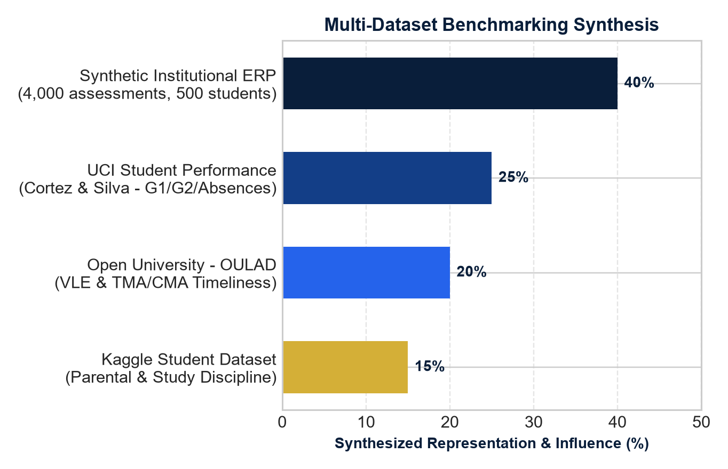
THE ICFAI FOUNDATION FOR HIGHER EDUCATION · DATASET ARCHITECTURE
Multi-Dataset Benchmarking & Synthesis
📚 Integration Across 4 Benchmark Datasets
• Kaggle Student Performance
Models parental education influence, independent study hours, and continuous formative quiz persistence patterns.
• UCI Student Performance (Cortez & Silva)
Maps G1 (Mid-Term /30), G2 (Continuous Internal /60), past failure history, and student absenteeism to academic risk.
• Open University Learning Analytics (OULAD)
Integrates VLE clickstream interactions, TMA (Tutor-Marked) and CMA (Computer-Marked) assessment submission timeliness.
• Synthetic Institutional ERP Dataset
4,000 real-world course assessments across Sections A–J, 60/40 mark splits, 2,400 attendance sessions, and 40,000 attendance records.
Special Project: AI-Based Autonomous Academic Decision System | Faculty Guides: Mrs. Madhusmita Majhi & Dr. D. Krishna Madhuri
Slide 4 of 14

Slide 5
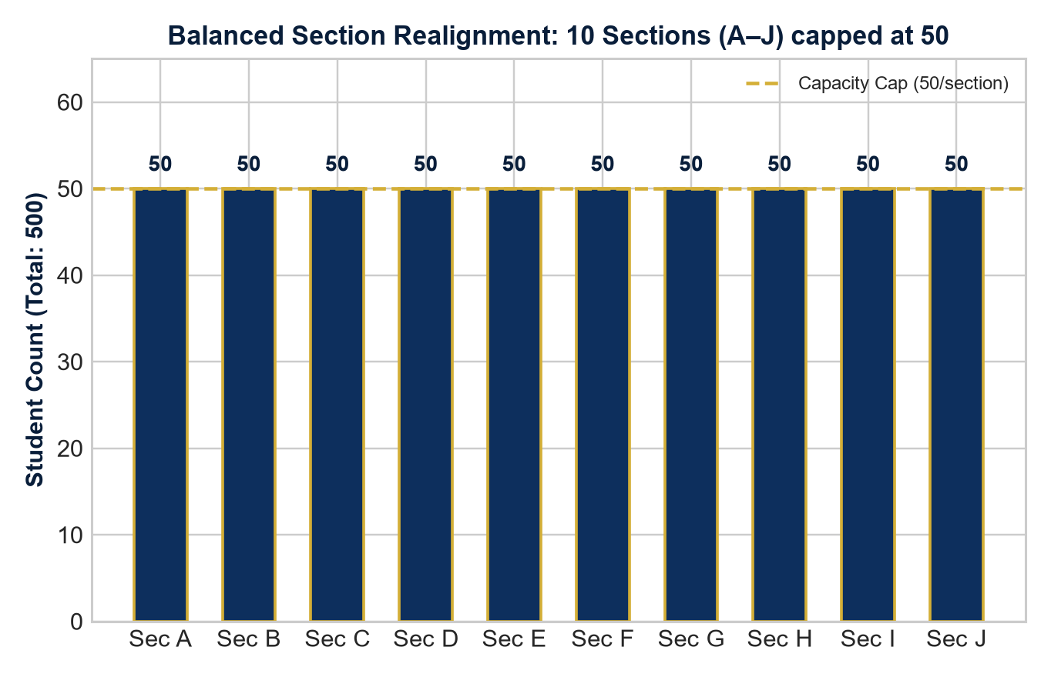
THE ICFAI FOUNDATION FOR HIGHER EDUCATION · ACADEMIC STRUCTURE
Academic Realignment: 10 Sections (A–J, 50 Capacity)
🏛️ Realistic Institutional Realignment
✔ Balanced Cohort Distribution
Realigned the previous 3-section unworkable structure into exactly 10 Sections (Sections A through J) capped at 50 students each (total 500 students).
✔ Uniform Year 1 Semester 1 Cohort
All 500 students belong to Year 1, Semester 1 across CSE, AIML, and AIDS, establishing realistic first-year academic dynamics.
✔ Accredited 20-Credit Curriculum
Students are enrolled across 8 accredited courses (5 Core Theory totaling 15 credits, 3 Practical Labs totaling 5 credits).
✔ Timetable & Section Roster Integrity
630 weekly timetable slots (Monday to Saturday, P1 to P7). Each course section maps to the exact 50 registered students for grading and attendance.
Special Project: AI-Based Autonomous Academic Decision System | Faculty Guides: Mrs. Madhusmita Majhi & Dr. D. Krishna Madhuri
Slide 5 of 14

Slide 6
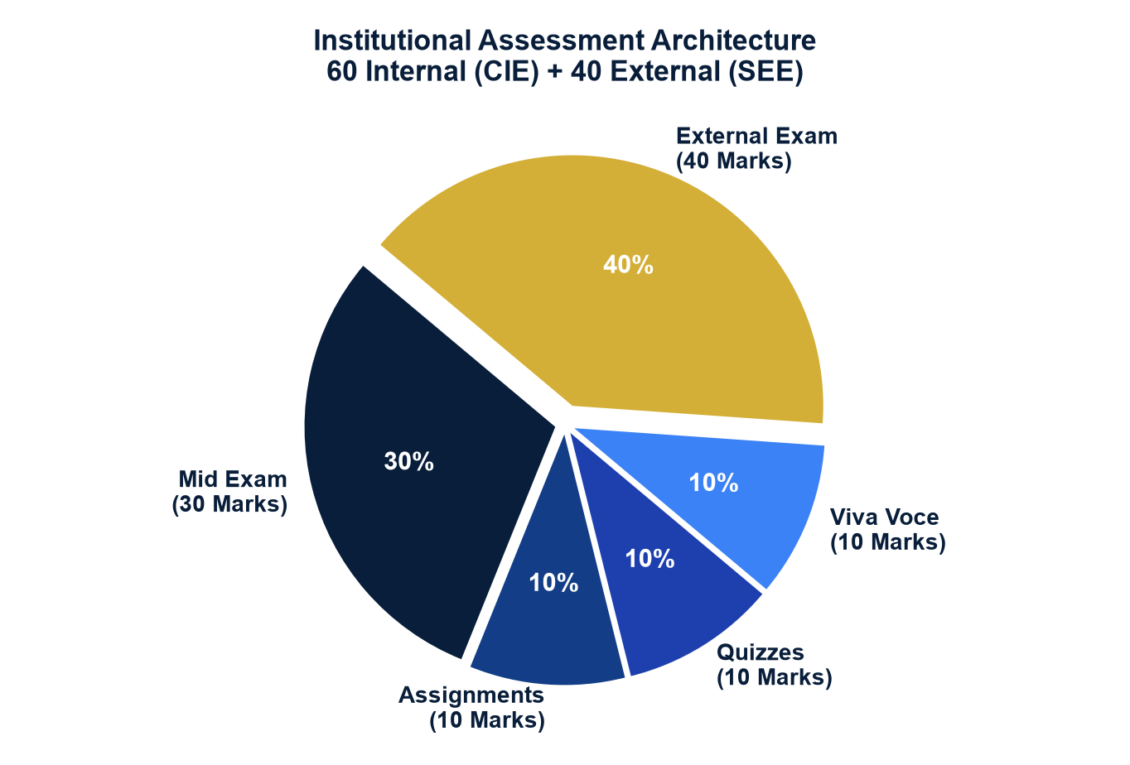
THE ICFAI FOUNDATION FOR HIGHER EDUCATION · EVALUATION SCHEME
Continuous Internal Evaluation (CIE) 60/40 Scheme
⚖️ 100-Mark Course Evaluation Framework
• 60 Internal Marks (CIE)
Divided into 4 continuous evaluation pillars:
• Mid-Term Examination: 30 Marks
• Continuous Assignments: 10 Marks
• Formative Online Quizzes: 10 Marks
• Practical Viva Voce / Lab Evaluation: 10 Marks
• 40 External Marks (SEE)
Summative End-Semester University Examination conducted by the institutional examination controller.
• Faculty-Only Permissions
Marks and session attendance can only be entered by the faculty assigned to that specific timetable slot and course section.
• UGC Letter Grading System
O (≥90), A+ (80–89), A (70–79), B+ (60–69), B (50–59), C (40–49), F (<40 Course Backlog).
Special Project: AI-Based Autonomous Academic Decision System | Faculty Guides: Mrs. Madhusmita Majhi & Dr. D. Krishna Madhuri
Slide 6 of 14

Slide 7
THE ICFAI FOUNDATION FOR HIGHER EDUCATION · INSTITUTIONAL GOVERNANCE
Strict ERP Semester Registration Gatekeeper
🔒 Institutional Rule Enforcement
• Strict Lockdown Workflow:
Under real-world institutional policy, students must formally register for their active semester before being evaluated. Unregistered students have zero marks, zero attendance records, and zero predictions.
• No Direct Posting:
Eliminates the flaw of premature grading: faculty cannot post marks or submit session attendance for unregistered students.
• Statutory Warning Banner:
When an unregistered student logs in, an Academic Hold alert is displayed, and gradebook, timetable, and predictions are completely hidden.
• Audit Receipt Generation:
Upon completing registration, an official verified registration receipt with timestamp and enrolled courses is issued.
📋 Registration Flow Comparison
▶ Unregistered Student State
❌ Internal Marks (CIE): Withheld
❌ External Marks (SEE): Withheld
❌ Session Attendance: Inaccessible
❌ AI Predictions: Locked
👉 Display: Semester Registration Wizard with seat cap (50) and course list
▶ Registered Student State
✅ 8 Enrolled Courses (20 Credits) Unlocked
✅ 60/40 Course Assessment Gradebook Active
✅ Weekly Class Timetable (Mon–Sat) Visible
✅ Live Attendance Ledger with 75% Tracker
✅ Real-Time AI Performance & Risk Radar
Special Project: AI-Based Autonomous Academic Decision System | Faculty Guides: Mrs. Madhusmita Majhi & Dr. D. Krishna Madhuri
Slide 7 of 14

Slide 8
THE ICFAI FOUNDATION FOR HIGHER EDUCATION · DATA ENGINEERING
Data Preprocessing & Feature Engineering
🧹 Data Cleaning & Preprocessing (Phase 2)
• Missing Value Imputation:
Continuous internal components (Mid, Assignment, Quiz, Viva) and attendance percentages are imputed using section medians.
• Foreign Key & Integrity Verification:
Enforces relational constraints across students, semester registrations, courses, and faculty timetable mappings.
• Categorical Encoding:
Transforms course categories (Core/Lab/Humanity) and section identifiers into machine-readable numeric formats.
• Stratified 80/20 Holdout Split:
Partitions 4,000 course assessments into 3,200 training records and 800 test records, preserving class balances across sections.
🔬 Synthesized Behavioral Features
• Formative Mastery Index (FMI):
Combines continuous assignment timeliness and quiz performance to measure consistent formative effort.
• Examination Retention Index (ERI):
Measures mid-term exam performance (/30) as a predictor of summative end-semester exam success.
• Practical / Viva Fluency (PVF):
Evaluates hands-on lab and viva voce demonstration (/10) for experiential learning quality.
• Attendance Regularity Score (ARS):
Tracks course attendance percentage against the UGC 75% statutory minimum requirement.
• VLE Engagement Weight (VEW):
Synthesizes LMS clickstream frequency and deadline submission margins derived from OULAD benchmarks.
Special Project: AI-Based Autonomous Academic Decision System | Faculty Guides: Mrs. Madhusmita Majhi & Dr. D. Krishna Madhuri
Slide 8 of 14

Slide 9
THE ICFAI FOUNDATION FOR HIGHER EDUCATION · MACHINE LEARNING (PHASE 4)
Machine Learning Models & Algorithm Comparison
🤖 Dual Ensemble Model Architecture
▶ Model 1: Student Performance Prediction
Predicts the final academic achievement category:
• Distinction (CGPA ≥ 8.0, overall ≥ 75%)
• Pass (Cleared all courses, overall ≥ 40%)
• Fail (Course backlog, overall < 40%)
Algorithm: Random Forest Classifier (100 estimators)
▶ Model 2: At-Risk Student Detection
Identifies students requiring immediate academic intervention:
• High Risk (Attendance < 75% or internal < 24/60)
• Medium Risk (Marginal performance 40–59%)
• Low Risk (Healthy trajectory ≥ 60%)
Algorithm: Random Forest Classifier & Logistic Regression
📊 Algorithm Benchmark Comparison
• Random Forest Ensemble (Selected):
Holdout Acc: 97.4% (Perf), 99.0% (Risk)
Handles non-linear feature interactions, robust to outliers, zero overfitting via bagging.
• Decision Tree Classifier (Baseline):
Holdout Acc: 89.2% (Perf), 91.5% (Risk)
Highly interpretable rules but prone to high variance on continuous assessment edge cases.
• Logistic Regression (Linear Baseline):
Holdout Acc: 84.1% (Perf), 88.0% (Risk)
Effective for binary risk classification but underperforms on multi-class distinction boundaries.
Special Project: AI-Based Autonomous Academic Decision System | Faculty Guides: Mrs. Madhusmita Majhi & Dr. D. Krishna Madhuri
Slide 9 of 14

Slide 10
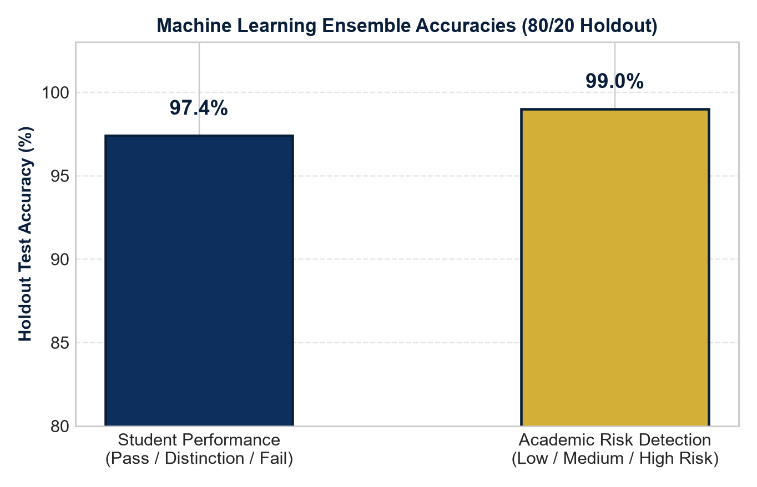
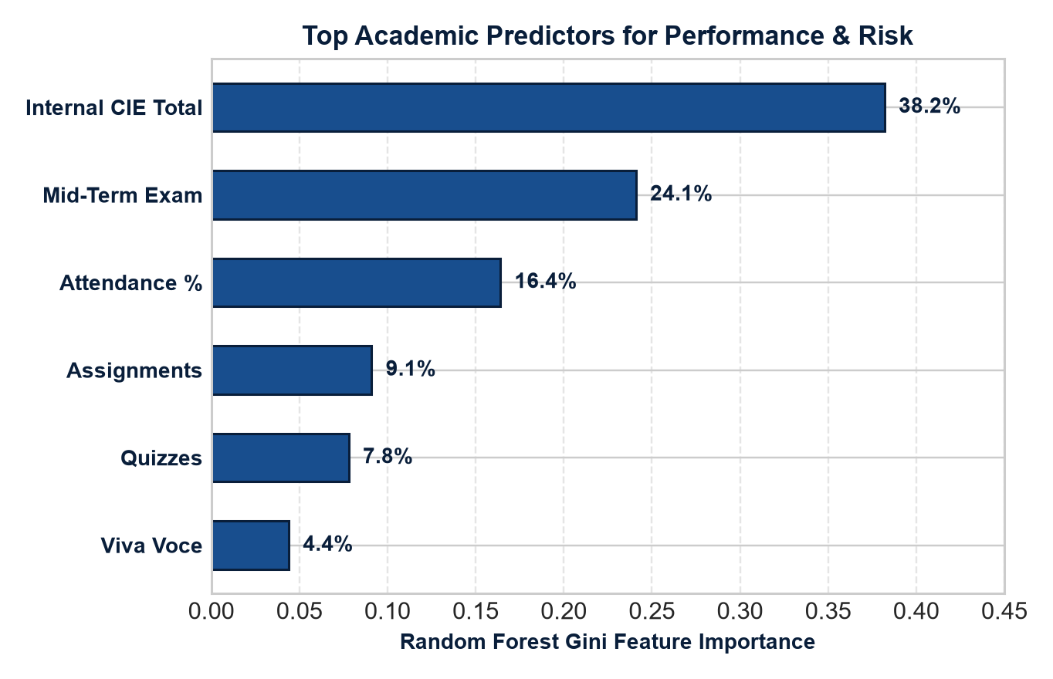
THE ICFAI FOUNDATION FOR HIGHER EDUCATION · EVALUATION & TESTING (PHASE 7)
Model Evaluation & Feature Importance
Special Project: AI-Based Autonomous Academic Decision System | Faculty Guides: Mrs. Madhusmita Majhi & Dr. D. Krishna Madhuri
Slide 10 of 14

Slide 11
THE ICFAI FOUNDATION FOR HIGHER EDUCATION · DECISION ENGINE (PHASE 5)
Autonomous Decision Engine & Targeted Interventions
🧠 Autonomous Intervention Triggers
🚨 High Risk Alert (Attendance < 75% | CIE < 24)
Immediately flags the student, issues automated email/SMS alerts to faculty advisors, and schedules mandatory counseling.
🚨 Statutory Attendance Shortage Warning
Calculates the exact number of consecutive upcoming lectures the student must attend without absence to regain exam eligibility.
🚨 Mid-Term Retention Support (< 15/30)
Automatically assigns departmental remedial tutorials and question banks covering high-weightage syllabus units.
🚨 Practical / Viva Voce Enhancement (< 6/10)
Triggers additional laboratory simulation practice and peer viva prep sessions.
🌟 Distinction Trajectory & High Achiever Engine
✅ Low Risk & Distinction Trajectory (Score ≥ 75)
Identifies high-performing students consistently maintaining ≥85% attendance and scoring above 45/60 in CIE.
✅ Honors & Research Incubation
Recommends students for undergraduate research assistantships, honors minors, and competitive hackathon teams.
✅ Peer Mentorship Program
Pairs top-tier distinction students as peer tutors for students in remedial tutorials, fostering collaborative learning.
✅ Multi-Channel Notification Dispatch
Sends automated commendations and academic advisory reports via local DB notifications, SMTP email, and Twilio SMS.
Special Project: AI-Based Autonomous Academic Decision System | Faculty Guides: Mrs. Madhusmita Majhi & Dr. D. Krishna Madhuri
Slide 11 of 14

Slide 12
THE ICFAI FOUNDATION FOR HIGHER EDUCATION · PORTAL DESIGN (PHASE 6)
Student Academic Portal (ICFAI IFHE Aesthetic)
🏛️ Faithful Reproduction of University ERP
• Institutional Header Banner:
Deep navy blue gradient with university crest, student initials avatar, roll number (26STU0001), program, and active registration badge.
• 7 Institutional Navigation Tabs:
1. 🏛️ Portal Overview & Student Profile
2. 📚 Academic Curriculum & Course Structure
3. 📊 CIE & External Gradebook (60/40 Scheme)
4. 📅 Timetable & Attendance System
5. 🧠 AI Academic Decision Engine
6. 🎯 Targeted Recommendations & Interventions
7. 🔔 University Notifications & Notices
• Statutory Attendance Warning Calculator:
Automatically highlights courses below 75% attendance with recovery targets to prevent examination debarment.
• Course Deep-Dive Visualizers:
Component contribution bars for Mid (/30), Assignment (/10), Quiz (/10), Viva (/10), and External (/40).
Reference: IFHE Student ERP Portal Interface
Special Project: AI-Based Autonomous Academic Decision System | Faculty Guides: Mrs. Madhusmita Majhi & Dr. D. Krishna Madhuri
Slide 12 of 14

Slide 13
THE ICFAI FOUNDATION FOR HIGHER EDUCATION · GOVERNANCE PORTALS (PHASE 6)
Faculty & Administrator Governance Workspaces
👨‍🏫 Faculty Evaluation Workspace
• Assigned Course Timetable Slots:
Faculty can only access courses and sections explicitly assigned to them in the timetable.
• CIE 60/40 Marks Entry:
Direct entry for Mid (/30), Assignment (/10), Quiz (/10), Viva (/10), and External (/40) for registered students.
• 50-Student Session Attendance Roster:
Daily attendance marking with full section roster (50 students), locked upon submission to maintain audit integrity.
• Early Warning At-Risk Student Filter:
Flags students with attendance < 75% or internal score < 24/60 with automated bulk notice dispatch.
🛡️ Administrator Intelligence Center
• Multi-Dataset ML Training Console:
One-click retraining of Random Forest ensembles directly from active ERP records, updating predictions across all 500 students.
• Live Model Evaluation & Importances:
Displays holdout accuracies (97.4% and 99.0%), feature weights, and historical training run logs.
• Institutional Dataset Explorer (4,000 Records):
Interactive filterable ledger across Sections A–J, courses, and risk tiers with CSV export.
• Curriculum & Admission Approvals:
Full control over student registrations, faculty timetable approvals, and password resets.
Special Project: AI-Based Autonomous Academic Decision System | Faculty Guides: Mrs. Madhusmita Majhi & Dr. D. Krishna Madhuri
Slide 13 of 14

Slide 14
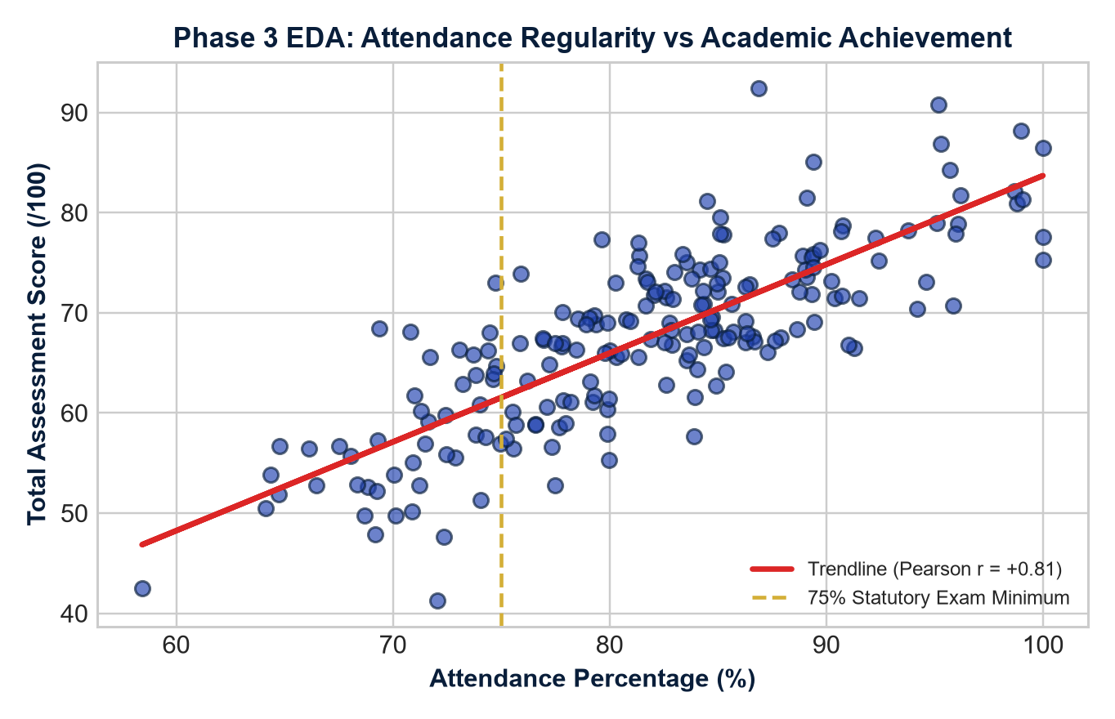
THE ICFAI FOUNDATION FOR HIGHER EDUCATION · SUMMARY & ROADMAP
Phase 3 EDA Insights, Future Scope & Conclusion
🚀 Project Milestone Achievements & Future Roadmap
✔ Key Empirical Insight (Pearson r = +0.81)
Statistically proves the strong positive correlation between class attendance regularity and total assessment scores.
✔ All 7 Project Phases Completed
1. Dataset Collection · 2. Preprocessing · 3. EDA · 4. AI Models · 5. Decision Engine · 6. Dashboards · 7. Testing & Evaluation.
✔ Future Enhancements
• Explainable AI (SHAP / LIME) for prediction transparency
• Real-time LMS clickstream API connectors
• Facial recognition biometric attendance integration
• Generative AI counseling summaries
✔ Academic Acknowledgments
Heartfelt gratitude to our Faculty Guides:
• Mrs. Madhusmita Majhi (Assistant Professor)
• Dr. D. Krishna Madhuri (Associate Professor)
Special Project: AI-Based Autonomous Academic Decision System | Faculty Guides: Mrs. Madhusmita Majhi & Dr. D. Krishna Madhuri
Slide 14 of 14

